Slide 1
HTML
Mini Course. Etan Rozin

Slide 2
What is HTML?
HTML (HyperText Markup Language) is not a programming language; it is a markup language, used to tell your browser how to structure the webpages you visit. It can be as complicated or as simple as the web developer wishes it to be.
In 1990, as part of his vision of the Web, Tim Berners-Lee defined the concept of hypertext, which Berners-Lee formalized the following year through a markup mainly based on SGML.

Slide 3
From simple beginnings now in...
Websites
Rich media web applications
Mobile web apps
Native Mobile applications (Ios, Android) via advanced frameworks
Hybrid native/web implementations (Windows 10 Store apps)

Slide 4
Examples of advanced web apps...
Google apps/Drive (this presentation, word processing, spreadsheets, file management).
Email.
Forms management. Jotforms
Canva. Online drawing
Zoho. Business applications
Maps, navigation
Online image editing
YouTube.

Slide 5
Tools
HTML is written as text and remains text throughout the life cycle, so it can be written with any text editor.
Notepad (notepad++), Free, extensible.
Atom (free, extendible, opensource).
Webstorm. Advanced, not free.
Sublime text. Advanced, popular, extensible, not free.
CodePen. Online editing/previewing.
JSfiddle. Online editing/previewing.

Slide 6
Interogating HTML
View Source.
Copy source into html editor for greater clarity.
Use developer tools to inspect html with great clarity.
Ctrl+Shift+I

Slide 7
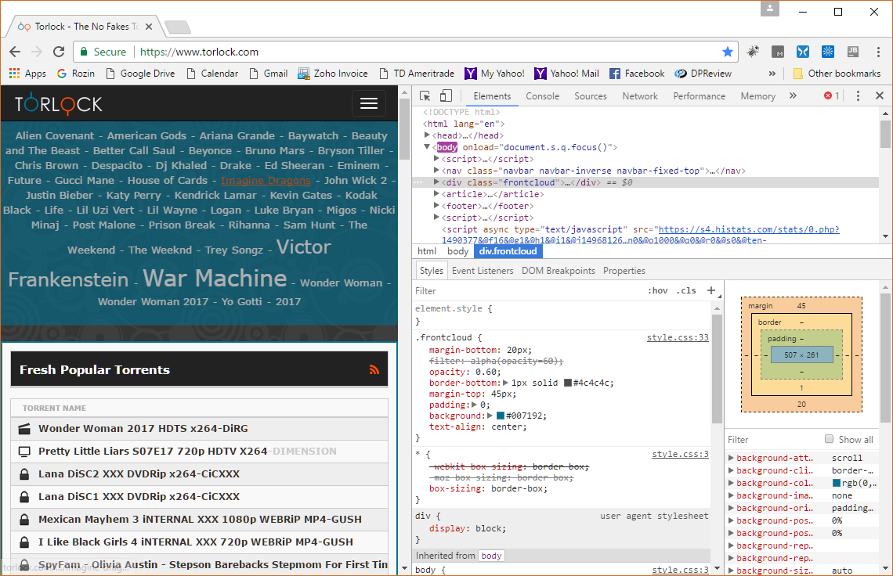
Browser Developer Tools

Slide 8
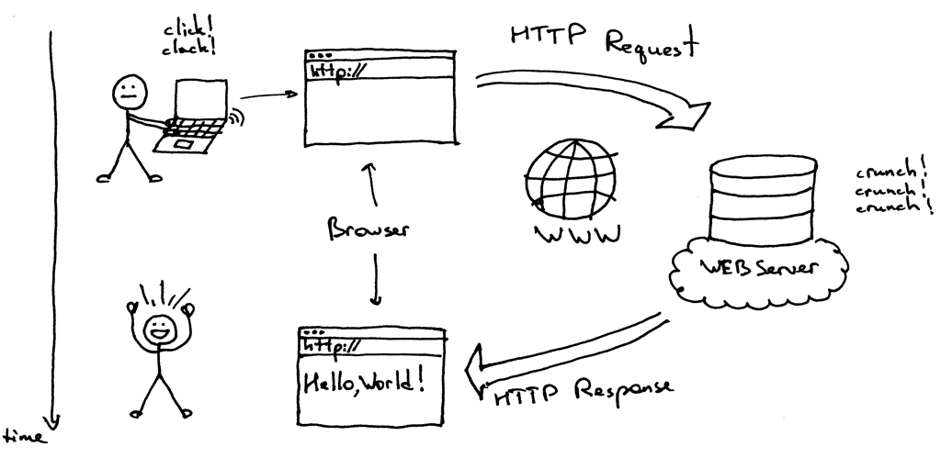
Static HTML page data flow

Slide 9
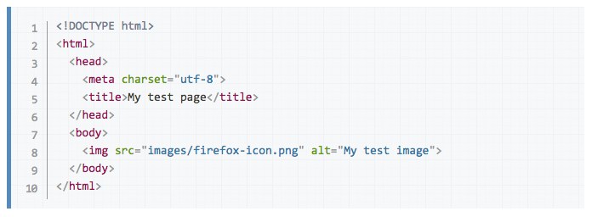
Anatomy of an HTML document

Slide 10
Ingredients in Header
Meta tags
Title
Links to external files
Scripts
Styles

Slide 11
Concept and syntax
An HTML document is a plaintext document structured with elements. Elements are surrounded by matching opening and closing tags. Each tag begins and ends with angle brackets (<>). There are a few empty or void tags that cannot enclose any text, for instance <img>.
You can extend HTML tags with attributes, which provide additional information affecting how the browser interprets the element:

Slide 12
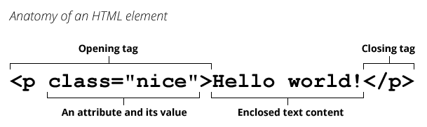
HTML elements

Slide 13
Element types in the HTML body
Text tags (headers, paragraphs)
Links (to external files and internal links)
Images
Lists
Tables
Form Elements
Blocks (geometric areas on page, sections)

Slide 14
Text Tags
<h1>This is heading 1</h1>
<p>This is a paragraph.</p>
<p>This is another paragraph.</p>
<p>This paragraph contains a lot of spaces in the source code,but the browser ignores it.</p>

Slide 15
Links
<a href="url">link text</a>
<a href="https://www.w3schools.com/html/">Visit our HTML tutorial</a>
<a href="https://www.w3schools.com/" target="_blank">Visit W3Schools!</a>
<a href="https://www.w3schools.com/" target="_self">Visit W3Schools!</a>
<a href="https://www.w3schools.com/" target="_parent">Visit W3Schools!</a>
<a href="#ContactArea">This is an internal link</a>

Slide 16


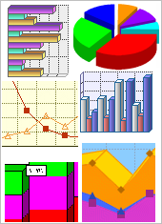

Images
Image formats: Discussion of format differences
GIF. 8 bit color, can have transparency, can have animation.
PNG. 8,24,32 bit color, can have transparency. No animation.
JPG. 8-24 bit color, no transparency, no animation
SVG. vector format, has transparency, animation using code
JPEG
GIF
PNG
SVG

Slide 17

Images
<img src="pic_mountain.jpg" alt="Mountain View" style = "width:304px;height:228px;">
<img src="pic_mountain.jpg" alt="Mountain View" style = "width:80px;">

Slide 18
Block vs. inline elements
Block level elements:
<div>
<h1> - <h6>
<p>
<form>
Inline level elements:
<span>
<a>
<img>

Slide 19
Block elements

Slide 20
Inline elements
Inline
Inline
Inline
Block
Inline
Inline
Inline

Slide 21
Lists
Unordered List
<ul>
<li>Coffee</li>
<li>Tea</li>
<li>Milk</li>
</ul>
Coffee
Tea
Milk

Slide 22
Lists
Ordered List
<ol>
<li>Coffee</li>
<li>Tea</li>
<li>Milk</li>
</ol>
Coffee
Tea
Milk

Slide 23
Tables
Tables used to be the only way to lay out a page. They are still an important way of displaying tabular / structured data.
Powerful extensions to plain vanilla tables exist that add functionality like sorting, editing, rearranging. (later)

Slide 24
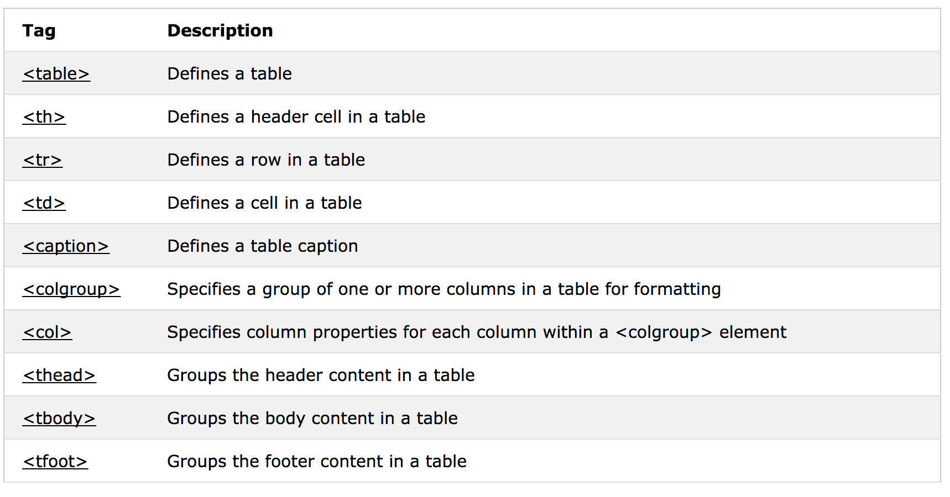
Table tags

Slide 25
HTML Forms
‘Classic’ HTML’s only way of sending information back from the browser to the server.
Collects information from the user in a structured way.
Different input elements for different types of data.
HTML 5 and modern browsers/mobile browsers respond to the data types with different input keyboards.

Slide 26
HTML Form basic
<form>
First name:<br>
<input type="text" name="firstname"><br>
Last name:<br>
<input type="text" name="lastname">
</form>

Slide 27
HTML Form elements
Text input
Password
Checkboxes (binary input)
Radio button (mutually exclusive selectors)
Select, drop down lists
File (upload a file)
Date
Number
Phone number
Email
Range

Slide 28
iframe
Including an HTML page in another HTML page.
<iframe src="demo_iframe.htm" height="200" width="300"></iframe>
No border:
<iframe src="demo_iframe.htm" style="border:none;"></iframe>
Target iframe:
<iframe src="demo_iframe.htm" name="iframe_a"></iframe>
<p><a href="https://www.w3schools.com" target="iframe_a">W3Schools.com</a></p>

